Slide 1
C/C++ Programming in a UNIX Environment
CS 3377
Bhanu Kapoor, PhD
Department of Computer Science University of Texas, Dallas, TX bhanu.kapoor@utdallas.edu
Notes Week 08
1

Slide 2
Reading for Week 08
□ Chapter 10 of A Practical Guide to Linux® Commands, Editors, and Shell Programming, Third Edition. Mark G. Sobell.
◼ Chapter 10: The Bourne Again Shell
1

Slide 3
Agenda
□ The Bourne-Again Shell (bash): Getting Started with Writing Scripts
1

Slide 4
bash
Startup Files
Redirecting Standard Error
Writing a Simple Shell Script
Job Control
Manipulating the Directory
Stack
Parameters and Variables
Processes
History
Re-executing and Editing
Commands
Functions
Controlling bash: Features and Options
Processing the Command Line
1

Slide 5
Specifying a shell
□ $ cat bash_script #!/bin/bash
echo "This is a Bourne Again Shell script.“
date
echo "Users Currently Logged In"
Who
□ $ cat tcsh_script #!/bin/tcsh
echo "This is a tcsh script." set person = zach
echo "person is $person"
1

Slide 6
Read Command
#!/bin/bash
echo -n “Enter name of file to delete: ”
read file
echo “Type 'y' to remove it, 'n' to change your mind ... ”
rm -i $file
echo "That was YOUR decision!”
The read command allows you to prompt for input and store it in a variable. Line 2 prompts for a string that is read in line 3. Line 4 uses the interactive remove (rm -i) to ask the user for confirmation.
1

Slide 7
Arithmetic Evaluation
□ The let statement can be used to carry out mathematical functions
$ let X=10+2*5
$ echo $X 20
$ let Y=X+2*5
$ echo $Y 30
1

Slide 8
Arithmetic Evaluation
□ An arithmetic expression can be evaluated by
$[expression] or $((expression))
$ echo “$((10+20))”
30
$ Z=$[10+20]
$ echo “$[5*$Z]”
□ ?
□ available operators: +, -, /, *, %
1

Slide 9
Symbols as Commands
() Subshell
$( )Command substitution
(( ))Arithmetic evaluation; a synonym for let
use when the enclosed value contains an equal sign
$(( )) Arithmetic expansion
not for use with an enclosed equal sign
1

Slide 10
() Subshell
□ $ (a ; b) & c &
[1] 15520
[2] 15521
□ $ (a ; b) & (c ; d) &
(cd tests ; cc test1.c) & (cd code; cc prog1.c) &
; to separate commands for sequential execution
$ x; y; z
$ x
$ y
10
$ z

Slide 11
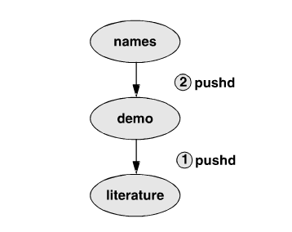
Directory Stack
$dirs
~/literature
$ pushd ../demo
~/demo ~/literature
$ pwd
/home/sam/demo
$ pushd ../names
~/names ~/demo ~/literature
$ pwd
/home/sam/names
$ pushd
◼ What happens?

Slide 12
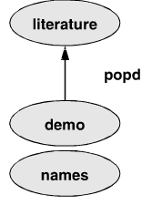
Directory Stack
$pushd +2
~/literature ~/demo ~/names
$ pwd
/home/sam/literature
$ dirs
~/literature ~/demo ~/names
$ popd
~/demo ~/names
$ pwd
/home/sam/demo

Slide 13
Variables and Parameters
To assign a value to a variable in the Bourne Again Shell, use the following syntax:
VARIABLE=value
There can be no whitespace on either side of the equal sign (=).
$ myvar=abc
$ TEMPDIR=/home/sam/temp
Under the TC Shell the assignment must be preceded by the word set and the SPACEs on either side of the equal sign are optional:
$ set myvar = abc

Slide 14
User Created Variables
$ person=max
$ echo person
person
$ echo $person
max
$ echo $PATH
To see which directories are part of search when looking for a command you typed in
$ unset person

Slide 15
Variable Attributes
readonly
$ person=zach
$ echo $person
zach
$ readonly person
$ person=helen
bash: person: readonly variable

Slide 16
Variable Attributes
(declare/typeset)
–a Declares a variable as an array
–f Declares a variable to be a function name
–i Declares a variable to be of type integer
–r Makes a variable readonly; also readonly
–x Exports a variable (makes it global); also
export
$ declare person1=max
$ declare -r person2=zach
$ declare -rx person3=helen
$ declare -x person4
□ $ declare -i COUNT
16

Slide 17
History
$ history | tail
23 PS1="\! bash$ "
ls -l
cat temp
rm temp
vim memo
lpr memo
vim memo
lpr memo
rm memo
history | tail
17

Slide 18
Referencing Events
You can reexecute the previous event by giving a !! command. In the following example, event 45 reexecutes event 44:
44 $ ls -l text
-rw-rw-r--
□ 45 $ !!
ls -l text
-rw-rw-r--
□ 51 $ !44
ls -l text
-rw-rw-r--
1 max group 45 Apr 30 14:53 text
1 max group 45 Apr 30 14:53 text
1 max group 45 Apr 30 14:53 text₁₈

Slide 19
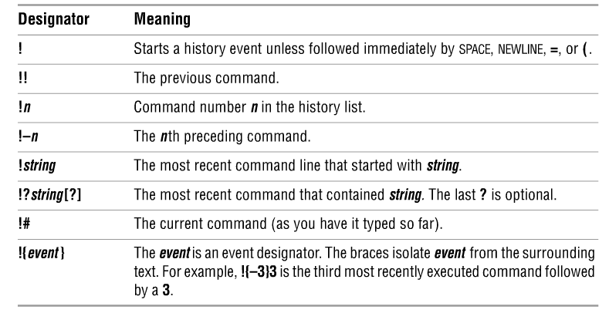
Event Designators

Slide 20
Aliases
alias [name[=value]]
alias ls='ls -l‘
$ alias
alias ll='ls -l' alias l='ls -ltr'
$ echo $PWD
□ /home/max
$ alias dirA="echo Working directory is $PWD“
$dirA
$ unalias dirA

Slide 21
Conditional Statements
□ Conditionals let us decide whether to perform an action or not, this decision is taken by evaluating an expression. The most basic form is:
if [ expression ]; then
statements
elif [ expression ]; then
statements else
statements
fi

Slide 22
Expressions
An expression can be: String comparison, Numeric comparison, File operators and Logical operators. It is represented by [expression]
String Comparisons:
= compare if two strings are equal
!= compare if two strings are not equal
-n evaluate if string length is greater than zero
-z evaluate if string length is equal to zero
Examples: [ s1 = s2 ] [ s1 != s2 ] [ s1 ]
[ -n s1 ]
[ -z s2 ]
(true if s1 same as s2, else false) (true if s1 not same as s2, else false) (true if s1 is not empty, else false)
(true if s1 has a length greater then 0, else false) (true if s2 has a length of 0, otherwise false)

Slide 23
Expressions
□ Number Comparisons:
-eq compare if two numbers are equal
-ge greater than or equal to a number
-le less than or equal to a number
-ne numbers are not equal
-gt one number is greater than another number
-lt one number is less than another number
□ Examples:
[ n1 -eq n2 ]
[ n1 -ge n2 ]
[ n1 -le n2 ]
(true if n1 same as n2, else false)
(true if n1 greater then or equal to n2, else false) (true if n1 less then or equal to n2, else false)

Slide 24
Example Conditional
$ cat user.sh #!/bin/bash
echo -n “Enter your login name: "
read name
if [ “$name” = “$USER” ]; //need spaces then
echo “Hello, $name. How are you today ?”
else
echo “You are not $USER, so who are you ?”
fi

Slide 25
Example Conditional
$ cat number.sh #!/bin/bash
echo -n “Enter a number 1 < x < 10: "
read num
if [ “$num” -lt 10 ]; then
if [ “$num” -gt 1 ]; then
echo “Number $num in range”
else
echo “Number $num out of range”
fi
fi
25

Slide 26
Expressions
□ Files operators:
-d check if path given is a directory
-f check if path given is a file
-e check if file name exists
-r check if read permission is set for file or directory
-s check if a file has a length greater than 0
-w check if write permission is set for a file or directory
-x check if execute permission is set for a file or directory
□ Examples:
[ -d fname ]
[ -f fname ]
[ -e fname ]
(true if fname is a directory, otherwise false)
(true if fname is a file, otherwise false) (true if fname exists, otherwise false)

Slide 27
Example
#!/bin/bash
if [ -f /etc/fstab ];
then
cp /etc/fstab .
echo “Done.”
else
echo “This file does not exist.”
exit 1
fi

Slide 28
Expressions
□ Logical operators:
! negate (NOT) a logical expression
-a logically AND two logical expressions
-o logically OR two logical expressions #!/bin/bash
echo -n “Enter a number 1 < x < 10:”
read num
if [ “$num” -gt 1 –a “$num” -lt 10 ]; then
echo “Number $num in range”
else
echo “Number $num out of range”
fi

Slide 29
Expressions
□ Logical operators:
&& logically AND two logical expressions
|| logically OR two logical expressions
Example:
#!/bin/bash
echo -n "Enter a number 1 < x < 10: " read num
if [ “$number” -gt 1 ] && [ “$number” -lt 10 ]; then
echo “Number $num in range”
else
echo “Number $num out of range”
fi

Slide 30
Case Statement
Use when if statement has a large number of conditions.
Value used can be an expression
each set of statements must be ended by a pair of semicolons;
a *) is used to accept any value not matched with list of values
case $var in
val1)
statements;; val2)
statements;;
*)
statements;;
esac

Slide 31
Example Case
$ cat case.sh #!/bin/bash
echo -n “Enter a number 1 < x < 5: ”
read x case $x in
echo “Value of x is 1.”;;
echo “Value of x is 2.”;;
echo “Value of x is 3.”;;
echo “Value of x is 4.”;;
echo “Value of x is 5.”;;
*) echo “Unrecognized value.”;;
esac

Slide 32
Iteration Statements
The for structure is used when you are looping through a range of variables.
for var in list do
statements done
statements are executed with var set to each value in the list.

Slide 33
Iteration Example
#!/bin/bash let sum=0
for num in 1 2 3 4 5 do
let “sum = $sum + $num”
done echo $sum
33

Slide 34
Iteration Example
#!/bin/bash
for x in paper pencil pen
do
echo “The value of variable x is: $x”
sleep 1 done

Slide 35
Iteration Example
if the list part is left off, var is set to each parameter
passed to the script ( $1, $2, $3,…)
$ cat for1.sh
#!/bin/bash for x
do
echo “The value of variable x is: $x”
sleep 1 done
$ for1.sh arg1 arg2
The value of variable x is: arg1
The value of variable x is: arg2

Slide 36
Functions
□ The syntax that declares a shell function is
[function] function-name ()
{
commands
}
where the word function is optional, function- name is the name you use to call the function, and commands comprise the list of commands the function executes when you call it. The commands can be anything you would include in a shell script, including calls to other functions.

Slide 37
Function Example
$ function whoson ()
{
date
echo "Users Currently Logged On"
who
}
$ whoson
Sun Aug 9 15:44:58 PDT 2009
Users Currently Logged On
hls | console | Aug 8 08:59 | (:0)
max | pts/4 | Aug 8 09:33 | (0.0)

Slide 38
Function
#!/bin/bash echo hello
whoson ()
{
date
echo "Users Currently Logged On" who
}
whoson

Slide 39
Script Examples
Try our conditional and iteration examples
Write a shell script which:
accepts a file name
checks if file exists
if file exists, copy the file to the same name
+ .bak + the current
When done you should have the original file and one with a .bak at the end.

